Slide 1
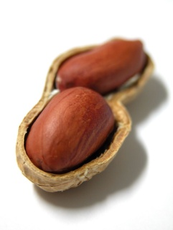
The Bible in a Nutshell
Burton Christadelphians
All images and text apart from Scripture quotations
are copyright The Christadelphians
Part 1

Slide 2
Jesus and the Old Testament

Slide 3
Do we need the Old Testament?
There are 39 books in the O.T.
Jesus believed in the O.T. stories.
Jesus quoted from the O.T.

Slide 4
From Genesis
Jesus talked about:
Noah – see Luke 17 v 26-27
Abraham – see Luke 13 v 28
“and all the prophets” - see Luke 13 v 28

Slide 5
From Exodus
Jesus talked about:
Moses – see Luke 20 v 37

Slide 6
From Leviticus
Jesus talked about:
The Law of Leprosy
– compare Luke 5 v 12 – 14
with Leviticus 14 v 1 onwards.

Slide 7
From Numbers
Jesus talked about:
The Serpent of Bronze
– compare John 3 v 14
with Numbers 21 v 9.

Slide 8
From Deuteronomy
Jesus quoted from this book during His temptations in the wilderness:
- compare Luke 4 v 4 with
Deuteronomy 8 v 3.

Slide 9
So Jesus endorsed all
5 books of “the Law”.

Slide 10
Now let's look at some of
“the history”.

Slide 11
Jesus talked about:
David – see Luke 6 v 3
Solomon – see Luke 12 v 27
Elijah - see Luke 4 v 26
Elisha– see Luke 4 v 27

Slide 12
These people appear in:
1st and 2nd Samuel;
1st and 2nd Kings;
1st and 2nd Chronicles.

Slide 13
So Jesus endorsed these 6 books of “history”.

Slide 14
The Prophets
We saw in Luke 13 v 28 that Jesus referred to “all the prophets”.
We can count a clear 17
“prophetic books”.

Slide 15
So:
5 books of “the Law”;
6 books of “history”;
17 books of “the prophets”;
Jesus endorsed at least 28 out of the 39 books of the Old Testament!

Slide 16
If Jesus trusted the Old Testament, so should we!

Slide 17
Reasons to Believe the Bible

Slide 18
The Evidence – You Decide
Accurate predictions
A Law Ahead of its Time
The Bible and Science
Archaeology
A Consistent Message

Slide 19
God’s Challenge
“I am the First and I am the Last;
Besides Me there is no God.
And who can proclaim as I do?
Then let him declare it and set it in order for Me, since I appointed the ancient people.
And the things that are coming and shall come, let them show these to them.”
Isaiah 44:6-7

Slide 20
Is the Bible Reliable?
Prophecies about Israel:
Scattered
Persecuted
Regathered
Ongoing Conflicts

Slide 21
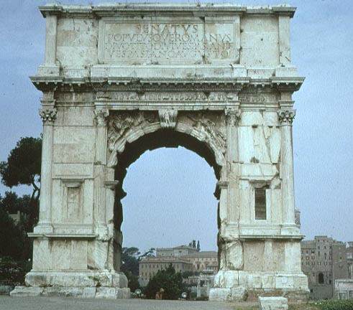
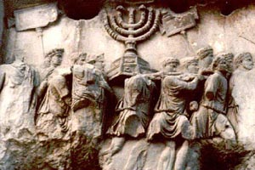
Israel Scattered
Then the LORD will scatter you among all peoples, from one end of the earth to the other, and there you shall serve other gods, which neither you nor your fathers have known
Deuteronomy 28:64

Slide 22
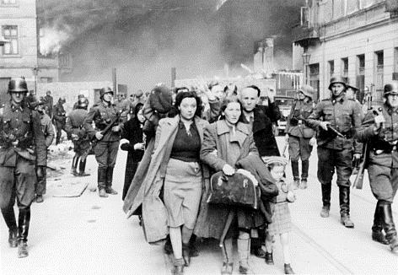
Israel Persecuted
And among those nations you shall find no rest, nor shall the sole of your foot have a resting place; but there the LORD will give you a trembling heart, failing eyes, and anguish of soul.
Your life shall hang in doubt before you; you shall fear day and night, and have no assurance of life.
Deuteronomy 28:65-66

Slide 23
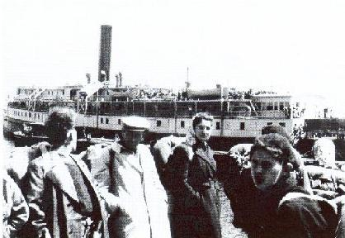
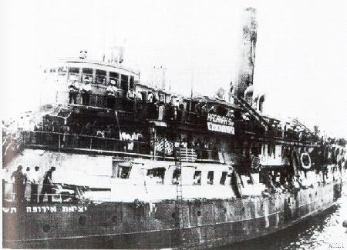
Israel Regathered
If any of you are driven out to the farthest parts under heaven, from there the LORD your God will gather you, and from there He will bring you.
Then the LORD your God will bring you to the land which your fathers possessed, and you shall possess it. He will prosper you and multiply you more than your fathers.
Deuteronomy 30:4-5

Slide 24
A Miracle of Survival!
No other nation in history has retained its identity after being:
Driven out of its homeland
Persecuted wherever its people went
Regathered to its original homeland after nearly 2000 years

Slide 25
Prophecy of Regathering
“Therefore behold, the days are coming,” says the LORD, “that it shall no more be said, ‘The LORD lives who brought up the children of Israel from the land of Egypt,’ but, ‘The LORD lives who brought the children of Israel from the land of the north and from all the lands where He had driven them.’ For I will bring them back into their land which I gave to their fathers... And they shall know that My name is the LORD”
Jeremiah 16:14-15, 21

Slide 26
Prophecy of Regathering
Who is the message from?
Who is the message to?
For what reason is the message given?
What does it mean?
God
Israel
That the Nation may know that God exists
The Jews would return to their land

Slide 27
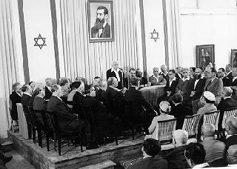
A Bible Student’s Observation
"There is… a... restoration of the Jews before the manifestation [i.e. return of Jesus]... The... colonization of Palestine will be on purely political principles; and the Jewish colonists will return in unbelief of the Messiahship of Jesus, and of the truth as it is in him…"
(John Thomas, Elpis Israel, 1849).
The State of Israel Declared
May 14, 1948

Slide 28
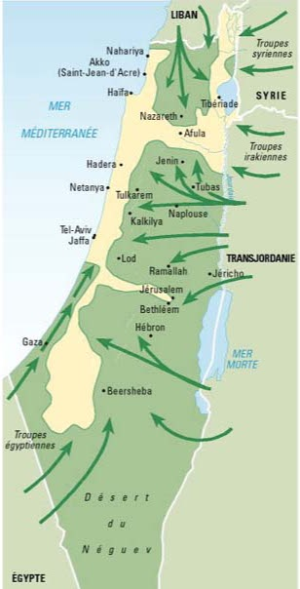
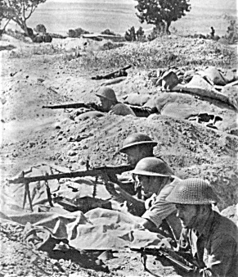
Ongoing Conflicts
They have said,
“Come, and let us cut them off from being a nation,
That the name of Israel may be remembered no more”.
Psalm 83:4

Slide 29
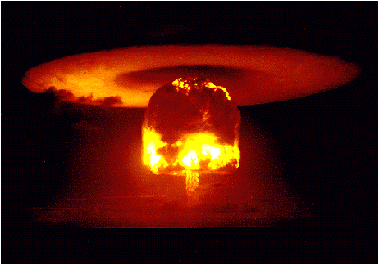
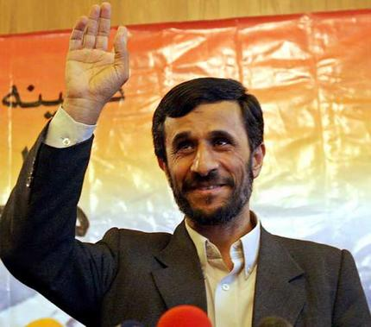
Ongoing Conflicts
They have said,
“Come, and let us cut them off from being a nation,
That the name of Israel may be remembered no more”.
Psalm 83:4

Slide 30
The Purpose of Prophecy
To offer irrefutable evidence that:
God does exist – because such grand predictions are humanly impossible
God is in control of our world
The Bible is, therefore, the Word of God.
It is true! You can trust it.

Slide 31
The Kingdom of God Explained

Slide 32
The Kingdom of God explained
What was the main theme of Jesus’ teaching?

Slide 33
The Kingdom of God explained
“Now after John was put in prison, Jesus came to Galilee, preaching the gospel of the kingdom of God, and saying, ‘The time is fulfilled, and the kingdom of God is at hand. Repent and believe in the gospel.’”
Mark 1:14-15

Slide 34
The Kingdom of God explained
“Now when it was day, he departed and went into a deserted place. And the crowd sought him and came to him, and tried to keep him from leaving them; but he said to them, ‘I must preach the kingdom of God to the other cities also, because for this purpose I have been sent.”
Luke 4:42-43

Slide 35
The Kingdom of God explained
“He … presented himself alive after his suffering by many infallible proofs, being seen by them during forty days and speaking of the things pertaining to the kingdom of God.”
Acts 1:3

Slide 36
The Kingdom of God explained
“But when they believed Philip as he preached the things concerning the kingdom of God and the name of the Lord Jesus Christ, both men and women were baptized.”
Acts 8:12

Slide 37
The Kingdom of God explained
“Then Paul dwelt two whole years in his own rented house, and received all who came to him, preaching the kingdom of God and teaching the things which concern the Lord Jesus Christ with all confidence, no man forbidding him.”
Acts 28:30-31

Slide 38
The Kingdom of God explained
Why did Jesus do miracles?

Slide 39
The Kingdom of God explained
Because he had power to do good, so he
did it

Slide 40
The Kingdom of God explained
Because he had power to do good, so he
did it
They were proof that he was from God

Slide 41
The Kingdom of God explained
Because he had power to do good, so he
did it
They were proof that he was from God
They were a foretaste of the kingdom of God

Slide 42
The Kingdom of God explained
“Then the eyes of the blind shall be opened, and the ears of the deaf shall be unstopped.
Then the lame shall leap like a deer, and the tongue of the dumb shall sing.
For waters shall burst forth in the wilderness, and streams in the desert.”
Isaiah 35:5-6

Slide 43
The Kingdom of God explained
“Then Jesus went about all the cities and villages, teaching in their synagogues, preaching the gospel of the kingdom, and healing every sickness and every disease among the people.”
Mark 9:35

Slide 44
The Kingdom of God explained
Fantastic! Let’s get ready for the kingdom!

Slide 45
The Kingdom of God explained
Luke 19:11-27

Slide 46
The Kingdom of God explained
Jesus will set up the kingdom of God

Slide 47
The Kingdom of God explained
“‘Men of Galilee, why do you stand gazing up into heaven? This same Jesus, who was taken up from you into heaven, will so come in like manner as you saw him go into heaven.’”
Acts 1:11

Slide 48
The Kingdom of God explained
“Seek ye first the kingdom of God and his righteousness.’”
Matthew 6:33

Slide 49
The Bible in a Nutshell
Burton Christadelphians
All images and text apart from Scripture quotations
are copyright The Christadelphians
End of Part 1

