Slide 1
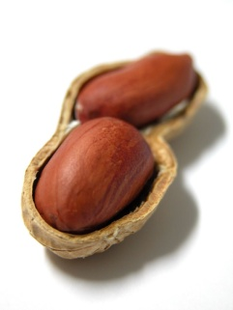
The Bible in a Nutshell
Burton Christadelphians
All images and text apart from Scripture quotations
are copyright The Christadelphians
Part 2

Slide 2
The Promises to Eve, Abraham, David & Mary

Slide 3
In the beginning
Adam and Eve faced a dreadful punishment when they disobeyed God but a ray of hope was also given.
Eve was promised that one of her descendants would reverse the dreadful punishment that had come on them.
This is a great promise which was fulfilled when Jesus Christ died on the cross.

Slide 4
In the beginning
“And I will put enmity between you and the woman,
And between thy seed and her Seed;
He shall bruise your head,
And you shall bruise His heel”
Genesis 3 v 15

Slide 5
There were many promises
Abraham lived about 4,000 years ago
God made a number of promises to Abraham. Fifteen are recorded in the Bible in the book of Genesis (chapters 12 to 22).
Some of these are referred to in the New Testament (Romans 4: 17-19; Galatians 3: 8-16; Hebrews 6: 14; 11: 8-19) which shows how important they are.

Slide 6
Promises to Abraham
I will make you a great nation;
I will bless you
I will bless those who bless you,
In you all the families of the earth shall be blessed.
Genesis 12: 1-3
Notes:
8

Slide 7
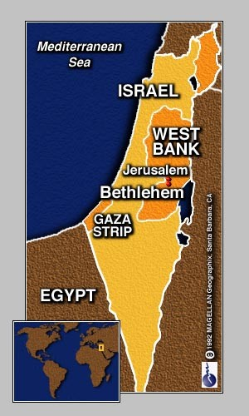
God was very specific
And the LORD said to Abram, after Lot had separated from him:
“Lift your eyes now and look from the place where you are - northward, southward, eastward, and westward;
for all the land which you see I give to you and your descendants forever.”
Genesis 13: 14-15

Slide 8
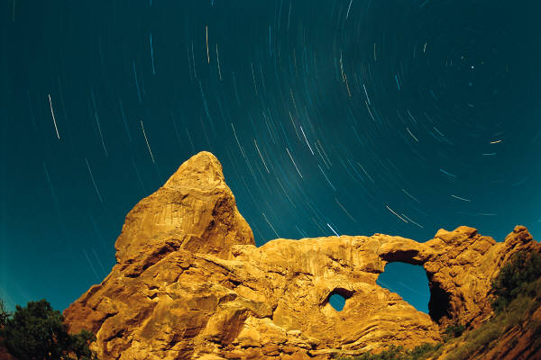
Promises to Abraham
  Then Abram said, “Look, you have given me no offspring; indeed one born in my house is my heir.” Then He brought him outside and said, “Look now toward heaven, and count the stars if you are able to number them.” And He said “So shall your descendants be”
  Genesis 15: 3 - 5

Slide 9
Promises to Abraham
Abraham would be the father of many nations
  (Jews and Arabs are descended from Abraham. Abraham’s new name means “Father of a multitude”.)
All nations would be blessed through Abraham and his descendants
Abraham and his descendants were promised the land of Canaan (Israel) as an everlasting possession

Slide 10
Promises to Abraham in the New Testament
Paul says that the promise to Abraham: “In you all nations shall be blessed”, is God preaching “the gospel to Abraham”.
When the promises to Abraham refer to a singular descendant (or “seed”), it is a reference to Jesus Christ.
Paul also explains that through belief and baptism into Christ, we can be counted as “Abraham’s seed”, and therefore heirs of the promises

Slide 11
David - a famous king of Israel
After saying how much He had done for David and the nation of Israel, God made many promises to him.
“When your days are fulfilled and you rest with your fathers, I will set up your seed after you, who will come from your body, and I will establish his kingdom. He shall build a house for My name, and I will establish the throne of his kingdom forever.”
2 Samuel 7: 12-13
Notes:
10

Slide 12
There was more
One special descendant (called his “Seed”)
God would be his Father
David’s house shall be established for ever
David’s throne shall be established for ever.
2 Samuel 7: 14-17
Notes:
12

Slide 13
The birth of Jesus Christ
This miraculous event was the start of the fulfillment of the promises we have already read.
“He will be great, and will be called the Son of the Highest; and the Lord God will give Him the throne of His father David.
And He will reign over the house of Jacob forever, and of His kingdom there will be no end.” Luke 1: 32-33

Slide 14
The New Testament begins…
“The book of the genealogy of Jesus Christ, the Son of David,
the Son of Abraham”
Matthew 1: 1
“The beginning of the gospel of
Jesus Christ, the Son of God”
Mark 1: 1-2

Slide 15
Why bother with the promises?
Abraham promised the land for ever
David promised the king for ever
The king is the Lord Jesus Christ
Jesus will be the king of the world
All nations will be blessed
Fulfilled when the Lord Jesus returns

Slide 16
Vitally important promises
“…the Scripture… preached the gospel to Abraham … saying, 'In you all the nations shall be blessed.'
So then those who are of faith are blessed with believing Abraham.”
Galatians 3: 8 - 9

Slide 17
We can share in these promises
For you are all sons of God through faith in Christ Jesus.
For as many of you as were baptized into Christ have put on Christ.
And if you are Christ's, then you are Abraham's seed, and heirs according to the promise.
Galatians 3: 26-27, 29

Slide 18
Jesus, the Promised Messiah
Notes:
Thank you Philip.
You’ll should notes on this presentation, starting on Page 15 of your booklet.

Slide 19

Jesus the Promised Messiah
Eve
Abraham
Did Jesus actually exist?
What does “Messiah” mean?
Is Jesus the Messiah?
Messiah’s promises for you
David
Mary
Messiah
Notes:
Well Philip has just shown us that through the centuries God has been making promises to men and women. He has promised a Messiah who would be a descendant of both Abraham and David. This Messiah would not only defeat sin and death, but also establish an everlasting Kingdom on earth. So who is this promised Messiah?
In order to answer this question, I’d like us to think about four key things.
Firstly, Before I even start to talk about Messiah, we have to ask ourselves whether Jesus actually existed – is he a real historical figure?
Secondly, I’ll then move on to talk about what the word Messiah actually means, and
Thirdly, whether Jesus of Nazareth is the Messiah that the Jews have looked for, for thousands of years.
Finally I’d like to talk about what the Messiah has got to do with you and me.

Slide 20
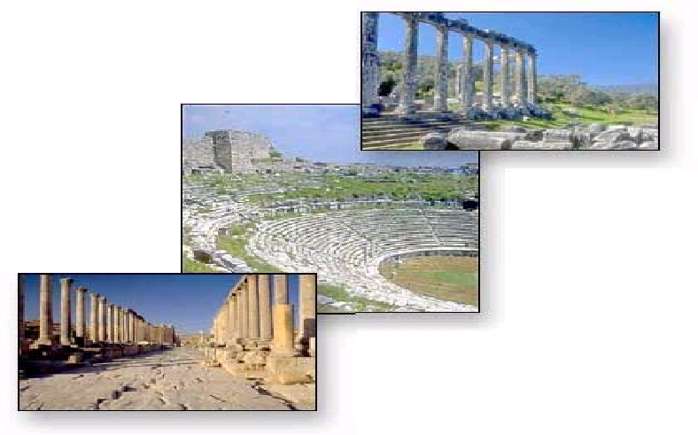
Voices of the past
Roman Emperors
Hadrian
Trajan
“Christus [Jesus]… was put to death by Pontius Pilate, procurator of Judea in the reign of Tiberius…”
(Cornelius Tacitus: Annals XV 44, A.D 52—54, writing on the expulsion of the Christians from Rome by Nero)
Other Writings
Mara Bar-Serapion
Phlegon
Thallus
Roman Officials
Tacitus
Pliny
Pontius Pilate
Suetonius
Jewish Historians
Josephus
Talmud
Greek Satirist
Lucian
Notes:
So did Jesus exist? Well, many who do not believe that Jesus is the Son of God still agree that Jesus existed. Most of the information we have about Jesus is contained in the Bible. In addition, many secular historians provide compelling evidence that Jesus lived in Israel around 2000 years ago.
Roman Emperors such as Hadrian and “Trayjan” mention Jesus and the Christians. Roman officials such as Cornelius Tacitus, Pliny, Pontius Pilate and “Sue-toni-us” all agree that Jesus lived, and they talk about him in their writings. The Jewish historian, Josephus, and the Jewish Talmud both speak of Jesus, and the list goes on.
These writers are not Christians, they are just people writing about their time, just as news reporters do today – The Lord Jesus Christ was big news, and as a result, we have more than purely religious writings to confirm this.

Slide 21
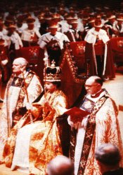
What does Messiah mean?
3rd June 1953
Messiah (Hebrew) = anointed
Christ (Greek) = anointed
A King or Priest was anointed with oil as a sign of their commitment to their task, and of God’s approval and selection of that individual.
“Be thy head anointed with holy oil as the kings, priests and prophets were anointed.”
Notes:
So “Messiah” and “Christ” words which both mean “anointed”.
On 3rd June 1953, Queen Elizabeth II was anointed with oil as part of her crowning ceremony. Oil was put on her head . As the archbishop did this, he said "Be thy head anointed with holy oil as the King's priests and prophets were anointed.“
Actually, the Queen’s anointing, was slightly different from biblical anointing where the oil was poured over the head. The archbishop just dipped his fingers in the oil and touched the queen’s head.
Both “Messiah” and “Christ” are titles that apply to Jesus because he was anointed to take the central role in Gods plan for the salvation of humankind. In ancient Israel, Kings and Priests were anointed with oil to show that God had chosen them for the job.
The twin role of sacrifice and Kingship is what it means to be God’s messiah. God’s Christ.

Slide 22
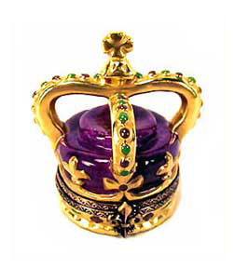
The Jewish View of Messiah
Descendant of David
Conquering King
Defeat Roman Occupation
Prosperity & Righteousness
Rule from Jerusalem
Notes:
So God promised David that he would have a special descendent who would be King over an everlasting Kingdom. This is the Messiah that Jews have always hoped for.
To the Jews of Jesus’ time, the Messiah would come as a conquering king, defeating the Romans and restoring the glories of the ancient kingdom of Israel. He would sit on King David’s throne and usher in a time of prosperity and righteousness. This gave the common people great hope.
This picture of the Messiah as king is quite correct—God’s kingdom will be established with Jesus as king, reigning from Jerusalem over a world at peace. The confusion arose because nobody realised that before the crown there had to come the cross.

Slide 23
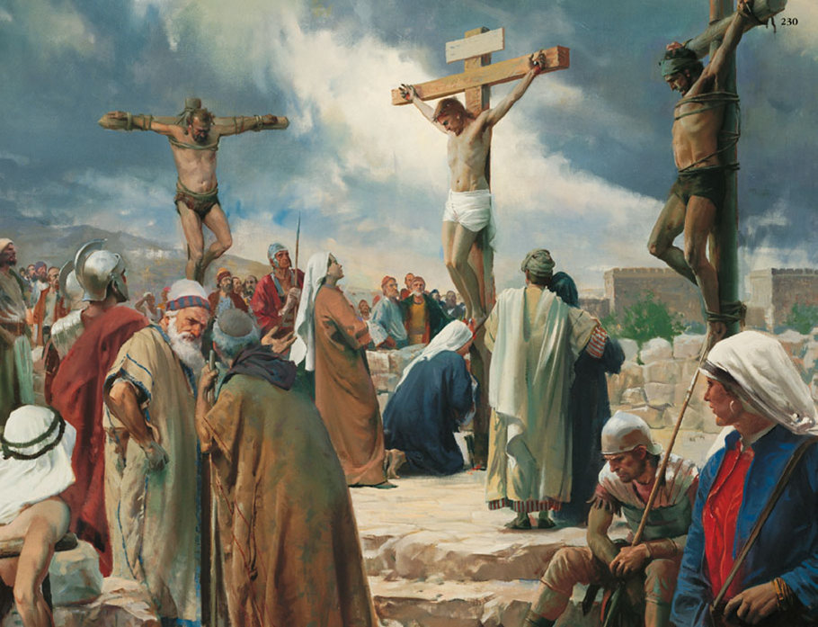
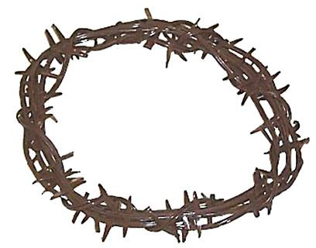
The Forgotten View of Messiah – the Suffering Servant
But he was wounded for our transgressions, He was bruised for our iniquities: the chastisement of our peace was upon Him; and by His stripes we are healed.
Isaiah 53:5
He is despised and rejected by men; a man of sorrows, and acquainted with grief
Isaiah 53:3
Notes:
The prophet Isaiah paints the most detailed picture of this aspect of the Messiah’s work. The Messiah is portrayed as a lamb going to the slaughter, a man quietly and willingly suffering in obedience to God himself.
“He is despised and rejected by men, A Man of sorrows and acquainted with grief…But He was wounded for our transgressions, He was bruised for our iniquities; The chastisement for our peace was upon Him, And by His stripes we are healed.”
This concept was utterly foreign to the Jews of Jesus’ day, both the common people and the religious leaders.

Slide 24
The Forgotten View of Messiah – the Suffering Servant
Messiah had to suffer
Jews missed it
Disciples missed it
Peter missed it!
Unpopular teaching
Notes:
They did not understand that passages like the one we just read were speaking about Jesus. When Jesus told his followers that he must die and be raised again, many, like Peter, Jesus’ most outspoken disciple, rejected the view that Messiah must die. Indeed, many early followers of Jesus lost interest in him when he continued to talk about suffering and self-denial rather than overthrowing the Roman oppressors. They did not understand that Jesus had to die to save them from sin and death. The cross had to come before the crown.

Slide 25
Summary So Far
Jesus did exist
In the Bible, “Messiah” means God’s anointed one, who was to suffer and die in order to defeat sin and death.
After his sacrificial death, Messiah would one day return as king of the world.
Is Jesus God’s Messiah?
Notes:
We have seen so far then that Jesus did exist. We have also learned that the word “Messiah” refers to God’s anointed one, who had to suffer and die to save us from our sins, before he becomes King of the world. This suffering aspect of Messiah is what the Jews did not understand, and is why many Jews rejected Jesus.
With that foundation laid, we come to our next question – Is Jesus of Nazareth God’s Messiah?

Slide 26
Old Testament Prophecies about Messiah
  A direct descendant of King David
  Born in Bethlehem
  Fled to Egypt from the persecution of King Herod
  Betrayed for 30 pieces of silver by a close friend
  Crucified
Notes:
Some people argue that Jesus deliberately set out to fulfil Old Testament Prophecies about the Messiah, and so deceive the people into believing a lie. Granted, there are certain Old Testament prophecies that Jesus could have selected to deliberately stage. For example, in an Old Testament book called Zechariah, there is a prediction that the Messiah would ride into Jerusalem on a donkey. This is exactly what Jesus did. “There you are,” say the critics, “Jesus knew about this prophecy and grabbed a donkey and rode in to Jerusalem.”
But, <PAUSE> what about all the prophecies which Jesus fulfilled that he couldn’t possibly have arranged himself? Let me give you just eight examples of what I mean:
How could Jesus have:
Be a direct descendant of King David?
Be born in Bethlehem?
Flee to Egypt from the persecution of King Herod?
Grow up in Nazareth?
Be betrayed for 30 pieces of silver by a close friend?
Be crucified?
Have his clothing divided amongst the soldiers, and the owner of his special tunic would be decided by casting lots?
Not have any of his bones broken on the cross?
Be raised from the dead?
I put it to you that Jesus could not have arranged these things, and that it is not reasonable to deny that Jesus is the Messiah on these grounds. Moreover, the fact that Jesus fulfilled hundreds of Old Testament prophecies about the Messiah, also proves that God exists, the Bible is true, and that God has a plan and is controlling world affairs.

Slide 27
An Old Testament Prediction of Jesus as God’s Suffering Messiah
Psalm 22 | Matthew 27
v7-8: All those who see me ridicule me; they shoot out the lip, they shake the head, saying, “He trusted in the Lord, let him rescue him; Let him deliver him, since he delights in him!" | v41-42: Likewise the chief priests also, mocking with the scribes and elders said …He trusted in God; let him deliver him now if he will have him; for he said, 'I am the Son of God.'
Notes:
Verses 7-8 of the Psalm read: “All those who see Me ridicule Me; They shoot out the lip, they shake the head, saying, 8 "He trusted in the Lord, let Him rescue Him; Let Him deliver Him, since He delights in Him!”. This again is precisely what happened at Jesus’ crucifixion. Matthew tells us that “the chief priests also, mocking with the scribes and elders said …He trusted in God; let Him deliver Him now if He will have Him; for He said, 'I am the Son of God.‘”

Slide 28
Old Testament Prophecies about Messiah
  A direct descendant of King David
  Born in Bethlehem
  Fled to Egypt from the persecution of King Herod
  Betrayed for 30 pieces of silver by a close friend
  Crucified
  Had his clothing divided amongst the soldiers, and the owner of his special tunic would be decided by casting lots
Notes:
Some people argue that Jesus deliberately set out to fulfil Old Testament Prophecies about the Messiah, and so deceive the people into believing a lie. Granted, there are certain Old Testament prophecies that Jesus could have selected to deliberately stage. For example, in an Old Testament book called Zechariah, there is a prediction that the Messiah would ride into Jerusalem on a donkey. This is exactly what Jesus did. “There you are,” say the critics, “Jesus knew about this prophecy and grabbed a donkey and rode in to Jerusalem.”
But, <PAUSE> what about all the prophecies which Jesus fulfilled that he couldn’t possibly have arranged himself? Let me give you just eight examples of what I mean:
How could Jesus have:
Be a direct descendant of King David?
Be born in Bethlehem?
Flee to Egypt from the persecution of King Herod?
Grow up in Nazareth?
Be betrayed for 30 pieces of silver by a close friend?
Be crucified?
Have his clothing divided amongst the soldiers, and the owner of his special tunic would be decided by casting lots?
Not have any of his bones broken on the cross?
Be raised from the dead?
I put it to you that Jesus could not have arranged these things, and that it is not reasonable to deny that Jesus is the Messiah on these grounds. Moreover, the fact that Jesus fulfilled hundreds of Old Testament prophecies about the Messiah, also proves that God exists, the Bible is true, and that God has a plan and is controlling world affairs.

Slide 29
An Old Testament Prediction of Jesus as God’s Suffering Messiah
Psalm 22 | The Gospels
V18: They divide my garments among them, and for my clothing they cast lots. | John 19:23-24: Then the soldiers, when they had crucified Jesus, took his garments and made four parts, to each soldier a part, and also the tunic. Now the tunic was without seam, woven from the top in one piece. They said therefore among themselves, "Let us not tear it, but cast lots for it, whose it shall be"
Notes:
Verse 18 of Psalm 22 is remarkable. It foretells the events of the crucifixion with amazing precision. Two things happen to the clothes of the executed man in Psalm 22 – some are divided amongst a group whereas part of his clothing is won by gambling in a game of chance. John explains to us exactly what happened: “Then the soldiers, when they had crucified Jesus, took His garments and made four parts, to each soldier a part, and also the tunic. Now the tunic was without seam, woven from the top in one piece. They said therefore among themselves, "Let us not tear it, but cast lots for it, whose it shall be.“
So we see that most of Jesus’ clothing was torn into four shares and divided between four soldiers, but when it comes to the tunic, it is so beautifully made that they do not want to tear it, so they cast lots for it – just as the Psalm predicted!
This taking of Jesus clothing is subtlety revealing to us the humiliation which Jesus suffered for us. If the soldiers had taken his clothing then we are being shown that Jesus was crucified naked, according to Roman custom. What shame he went through for us!
Psalm 22 clearly identifies that Jesus is indeed God’s promised Messiah, as do hundreds of other Old Testament predictions which were only true of Jesus.

Slide 30
Old Testament Prophecies about Messiah
  A direct descendant of King David
  Born in Bethlehem
  Fled to Egypt from the persecution of King Herod
  Betrayed for 30 pieces of silver by a close friend
  Crucified
  Had his clothing divided amongst the soldiers, and the owner of his special tunic would be decided by casting lots
  Not have any of his bones broken on the cross
  Be raised from the dead
Notes:
Some people argue that Jesus deliberately set out to fulfil Old Testament Prophecies about the Messiah, and so deceive the people into believing a lie. Granted, there are certain Old Testament prophecies that Jesus could have selected to deliberately stage. For example, in an Old Testament book called Zechariah, there is a prediction that the Messiah would ride into Jerusalem on a donkey. This is exactly what Jesus did. “There you are,” say the critics, “Jesus knew about this prophecy and grabbed a donkey and rode in to Jerusalem.”
But, <PAUSE> what about all the prophecies which Jesus fulfilled that he couldn’t possibly have arranged himself? Let me give you just eight examples of what I mean:
How could Jesus have:
Be a direct descendant of King David?
Be born in Bethlehem?
Flee to Egypt from the persecution of King Herod?
Grow up in Nazareth?
Be betrayed for 30 pieces of silver by a close friend?
Be crucified?
Have his clothing divided amongst the soldiers, and the owner of his special tunic would be decided by casting lots?
Not have any of his bones broken on the cross?
Be raised from the dead?
I put it to you that Jesus could not have arranged these things, and that it is not reasonable to deny that Jesus is the Messiah on these grounds. Moreover, the fact that Jesus fulfilled hundreds of Old Testament prophecies about the Messiah, also proves that God exists, the Bible is true, and that God has a plan and is controlling world affairs.

Slide 31
Did Jesus Fulfil Old Testament Prophecies by sheer coincidence?
The probability of one person fulfilling 48 Old Testament prophecies about the Messiah is:
One chance in a trillion, trillion, trillion, trillion, trillion, trillion, trillion, trillion, trillion, trillion, trillion, trillion, trillion!
Or 1 in 1,000,000,000,000,000,000,000,000,000,000,000,000,000,000,000,000,000,000,000,000,000,000,000,000,000,000, 000,000,000,000,000,000,000,000,000,000,000,000,000, 000,000,000,000,000,000,000,000,000,000,000,000,000!
Peter W. Stoner: Science Speaks (Moody Press, 1969) p109
Notes:
When presented with this kind of compelling evidence that Jesus is Messiah, however, some people argue that it’s just a coincidence that Jesus fulfilled Old Testament prophecies like Psalm 22.
But the coincidence argument is, unconvincing. There are hundreds of Old Testament prophecies about Jesus. And Peter Stoner, a mathematician, estimated that for one single person to fulfil just forty eight prophecies about the Messiah was about one chance in a… well, you can see the number on the slide. If you can’t see, I’m sorry, but I had to use small text to get all the zero’s on the slide.
You could, it takes more faith to believe that Jesus is not Messiah than to accept that he is the Messiah, spoken of in the Bible.

Slide 32
Summary
The Bible predicted that the Messiah would come.
The Jews knew this and were expecting him.
They did not recognise him when he came.
The Jews did not expect Messiah to suffer.
Jesus is the Messiah predicted in the Bible.
Jesus will return to become king.
Jesus will rule as king over the whole earth.
Notes:
The Bible predicted that The Messiah would come.
The Jews knew this and were expecting him.
They did not recognise him when he came.
The Jews did not expect Messiah to suffer.
Jesus is the Messiah predicted in the Bible.
Jesus will return to become king.
Jesus will rule as king over the whole earth.
Thank you very much for listening. I’m now going to hand over to Pete, and he’ll tell you more about God’s kingdom.

Slide 33
The Kingdom of Israel Restored

Slide 34
The Jews - a special treasure
God’s chosen people
1. “The Lord your God has chosen you to be a people for Himself, a special treasure above all the people on the earth”
Deuteronomy 7:6
2. “…because He would keep the oath which He swore to your fathers”
Deuteronomy 7:8
Has God rejected the Jews?
1. “Has God cast away His people? Certainly not!”
Romans 11:1
2. “They are beloved for the sake of the fathers”
Romans 11:28

Slide 35
The Kingdom of God in the past
The kings who chose to keep God’s commandments were forerunners of the future kingdom of God
David said:
“[God] has chosen my son Solomon to sit on the throne of the kingdom of the LORD over Israel”
1 Chronicles 28:5
The Kingdom of Israel pointed forward to the kingdom of God

Slide 36
Unfaithful Israel to be punished
“I will bring the land to desolation…I will scatter you among the nations and draw out a sword after you: your land shall be desolate and your cities waste”
Leviticus 26:32,33
“But for their sake I will remember the covenant of their ancestors”
Leviticus 26:45

Slide 37
Restoration Promised
“‘For behold the days are coming,’ says the LORD, ‘that I will bring from captivity my people Israel and Judah,’ says the LORD.
‘And I will cause them to return to the land that I gave to their fathers, and they shall possess it.’”
Jeremiah 30:3

Slide 38
God’s witnesses
“You are my witnesses,” says the LORD
Isaiah 43:10
The History of the Jews demonstrates:
God exists
His word is true and we can trust it

Slide 39
Israel in the Future
Jerusalem and Israel will be invaded by other nations
The Jews will experience a process of repentance and renewal
Jerusalem will become the capital and administrative centre of God’s kingdom
“For out of Zion shall go forth the law, and the word of the LORD from Jerusalem”
Isaiah 2:3

Slide 40
The future Kingdom on Earth

Slide 41
The future Kingdom on Earth
The kingdom of God in the past
The promised king (the Messiah)
The kingdom of Israel restored
The promised future kingdom

Slide 42
The future Kingdom on Earth
“‘Men of Galilee, why do you stand gazing up into heaven? This same Jesus, who was taken up from you into heaven, will so come in like manner as you saw him go into heaven.’”
Acts 1:11

Slide 43
The future Kingdom on Earth
Daniel 2

Slide 44
The future Kingdom on Earth
“The kingdoms of this world have become the kingdoms of our Lord and of his Christ, and he shall reign for ever and ever!”
Revelation 11:15

Slide 45
The future Kingdom on Earth
Situations vacant
WANTED
Someone to rule the world!

Slide 46
World ruler required
“And Jesus came and spoke to them, saying, ‘All authority has been given to me in heaven and on earth.’”
Matthew 28:18

Slide 47
World ruler required
“Christ, having been raised from the dead, dies no more. Death no longer has dominion over him. For the death that he died, he died to sin once for all; but the life that he lives, he lives to God.”
Romans 6:9-10

Slide 48
World ruler required
“But Jesus did not commit himself to them, because he knew all men, and had no need that anyone should testify of man, for he knew what was in man.”
John 2:24-25

Slide 49
What will the Kingdom be like?

Slide 50
What will the Kingdom be like?
“He has appointed a day on which he will judge the world in righteousness by the man whom he has ordained.”
Acts 17:31

Slide 51
What will the Kingdom be like?
“His delight is in the fear of the Lord, and he shall not judge by the sight of his eyes, nor decide by the hearing of his ears…
Isaiah 11:3

Slide 52
What will the Kingdom be like?
With righteousness he shall judge the poor, and decide with equity for the meek of the earth;
He shall strike the earth with the rod of his mouth, and with the breath of his lips he shall slay the wicked.”
Isaiah 11:4

Slide 53
What will the Kingdom be like?
“In his days the righteous shall flourish, and abundance of peace, until the moon is no more.”
Psalm 72:7

Slide 54
What will the Kingdom be like?
“‘Behold, the days are coming,’ says the Lord, ‘when the plowman shall overtake the reaper, and the treader of grapes him who sows seed; the mountains shall drip with sweet wine, and all the hills shall flow with it.”
Amos 9:13

Slide 55
What will the Kingdom be like?
“And it shall come to pass that everyone who is left of all the nations which came against Jerusalem shall go up from year to year to worship the king, the Lord of hosts, and to keep the Feast of Tabernacles.”
Zechariah 14:16

Slide 56
What will the Kingdom be like?
Isaiah 2

Slide 57
The Millennium
“But each one in his own order: Christ the firstfruits, afterward those who are Christ’s at his coming. Then comes the end, when he delivers the kingdom to God the Father, when he puts an end to all rule and all authority and power. For he must reign till he has put all enemies under his feet.”
1 Corinthians 15:23-25

Slide 58
The future Kingdom on Earth
“But truly, as I live, all the earth shall be filled with the glory of the Lord.”
Numbers 14:21

Slide 59
The future Kingdom on Earth
“The kingdoms of this world have become the kingdoms of our Lord and of His Christ, and He shall reign for ever!”
Revelation 11:15

Slide 60
The Millennium
Jesus Christ and the Saints will reign for 1000 years
  “…they lived and reigned with Christ for a thousand years.”
Revelation 20:4
Christ will subdue all rebellion and hand the kingdom back to God
  “Then comes the end, when he delivers the kingdom to God, the Father, when he puts and end to all rule and all authority and power.”
1 Corinthians 15:24

Slide 61
Jesus Christ is qualified to rule the World
He has personally triumphed over sin.
Hebrews 4:15
He has been made immortal - he will never die again. Romans 6:9
He knows what people are thinking, and can therefore correctly judge their motives.
Matthew 9:4
He has been granted power and authority by God. Matthew 28:18

Slide 62
Jesus is God’s king
“Jesus came and spoke to them, saying,
‘All authority has been given to Me in heaven and on earth’”
Matthew 28:18

Slide 63
The Future Kingdom
Everlasting peace worldwide
A Perfect Ruler
Oppression and Social inequality overcome
No more famine
Weapons of war converted to agricultural tools
God’s ways taught
All people will worship God

Slide 64
Future Kingdom on Earth
And in the days of these kings the God of heaven will set up a kingdom which shall never be destroyed; and the kingdom shall not be left to other people; it shall break in pieces and consume all these kingdoms, and it shall stand forever.
Daniel 2:44
Then the seventh angel sounded: And there were loud voices in heaven, saying, 'The kingdoms of this world have become the kingdoms of our Lord and of His Christ, and He shall reign forever and ever!'
Revelation 11:15

Slide 65
The Lord's Prayer
Our Father in heaven, hallowed be Your name.
Your kingdom come.
Your will be done on earth as it is in heaven.
Give us this day our daily bread.
And forgive us our debts, as we forgive our debtors.
And do not lead us into temptation,
But deliver us from the evil one.
For Yours is the kingdom and the power
And the glory forever. Amen.
Matthew 6:9-13

Slide 66
Future Kingdom on Earth
But truly, as I live, all the earth shall be filled with the glory of the LORD.
Numbers 14:21

Slide 67
Future Kingdom on Earth
Then I, John, saw the holy city, New Jerusalem, coming down out of heaven from God, prepared as a bride adorned for her husband.
And I heard a loud voice from heaven saying, 'Behold, the tabernacle of God is with men, and He will dwell with them, and they shall be His people. God Himself will be with them and be their God.
And God will wipe away every tear from their eyes; there shall be no more death, nor sorrow, nor crying. There shall be no more pain, for the former things have passed away.
Revelation 21:2-4

Slide 68
The Bible in a Nutshell
End of Part 2

