Slide 1
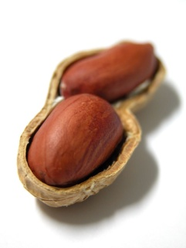
The Bible in a Nutshell
Burton Christadelphians
All images and text apart from Scripture quotations
are copyright The Christadelphians
Part 3

Slide 2
What Is Wrong With Us?

Slide 3
It’s not very nice, but …
“’For My thoughts are not your thoughts, nor are your ways, My ways,’ says the LORD”
Isaiah ch.55 v.8
“The heart is deceitful above all things and desperately wicked”
Jeremiah ch.17 v.9

Slide 4
It’s not very nice, but …
“For from within, out of the heart of men, proceed evil thoughts, adulteries, fornications, murders, thefts, covetousness, wickedness, deceit, lewdness, an evil eye, blasphemy, pride, foolishness. All these evil things come from within and defile a man”
Mark ch.7 v.21-23

Slide 5
It’s not very nice, but …
“… all have sinned and fall short of the glory of God”
Romans 3:23
“For the wages of sin is death, but the gift of God is eternal life in Christ Jesus our Lord.”
Romans 6: 23
We are all involved – no one is exempt

Slide 6
Our problem – root cause
“Therefore, just as through one man sin entered the world, and death through sin, and thus death spread to all men, because all sinned”
Romans ch.5 v.12
Because of our sins, we are separated from God, and our world is full of suffering

Slide 7
The reality of death
  “For in death there is no remembrance of You; in the grave who will give You thanks?”
  Psalm 6 v.5
  “For the living know that they will die; but the dead know nothing … Also their love, their hatred, and their envy have now perished …”
  Ecclesiastes ch.9 v.5-6

Slide 8
Our problem – God’s solution
“For God so loved the world that He gave His only begotten Son, that whoever believes in Him should not perish but have everlasting life.
For God did not send His Son into the world to condemn the world, but that the world through Him might be saved.”
John 3: 16 - 17
Notes:
3

Slide 9
Jesus’ message
We have to show that we accept God’s solution
“And He [Jesus] said to them, ‘Go into all the world and preach the gospel to every creature. He who believes and is baptized will be saved; but he who does not believe will be condemned.’”
Mark 16:15-16

Slide 10
The way of escape from sin
Do you not know that if you present yourselves to anyone as obedient slaves, you are slaves of the one whom you obey, either of sin which leads to death, or of obedience which leads to righteousness?
But thanks be to God, that though you were once slaves of sin have become obedient from the heart to the standard of teaching to which you were committed.
Romans 6: 16-17, ESV
Notes:
3

Slide 11
Resurrection – our only hope
There are two choices - which master do we serve?
For the trumpet will sound, and the dead will be raised incorruptible, and we shall be changed.
1 Corinthians 15: 52
Then shall be brought to pass the saying that is written: ‘Death is swallowed up in victory … But thanks be to God, who gives us the victory through our Lord Jesus Christ”
1 Corinthians 15: 54-57

Slide 12
Jesus’ own words
Do not marvel at this; for the hour is coming in which all who are in the graves will hear His voice and come forth - those who have done good, to the resurrection of life, and those who have done evil, to the resurrection of condemnation.
John 5: 28-29
Notes:
3

Slide 13
No more pain or suffering
“And God will wipe away every tear from their eyes; there shall be no more death, nor sorrow, nor crying. There shall be no more pain, for the former things have passed away. ”
Revelation 21: 4-5
Notes:
3

Slide 14
Why was Jesus Christ crucified?

Slide 15
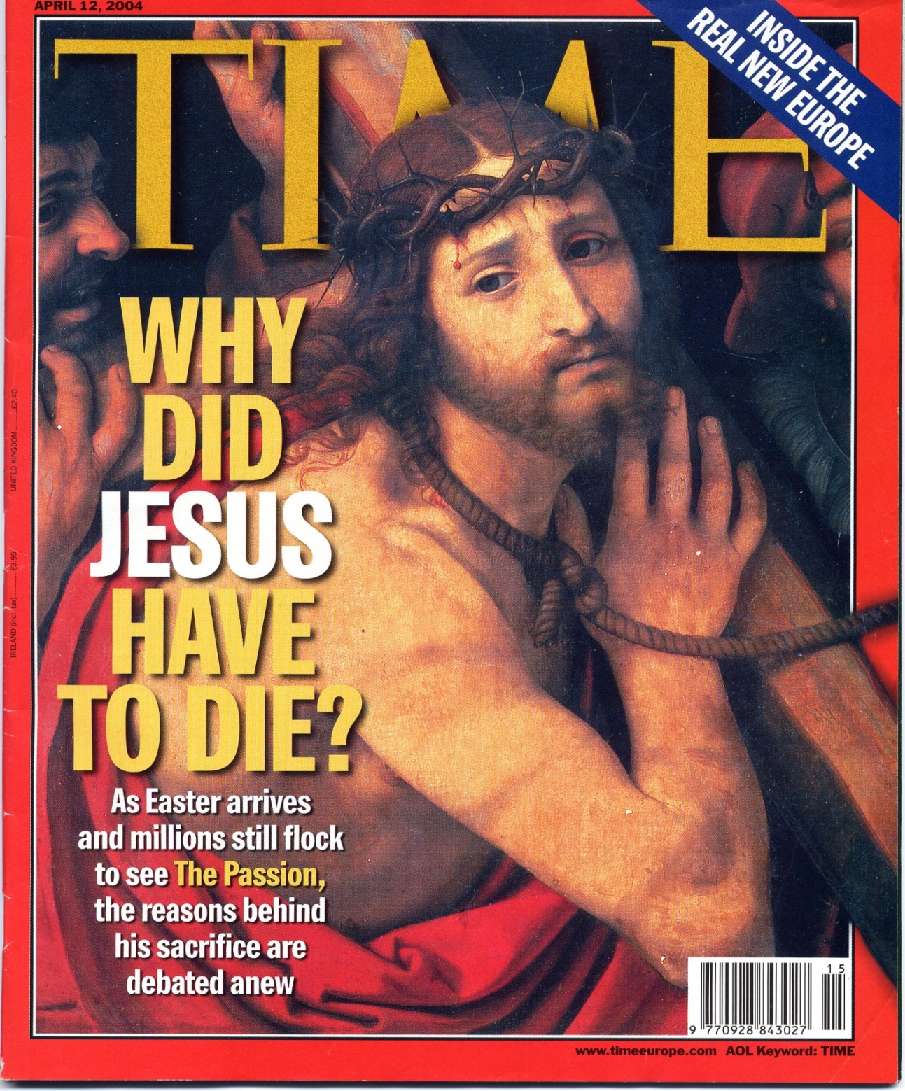

Slide 16
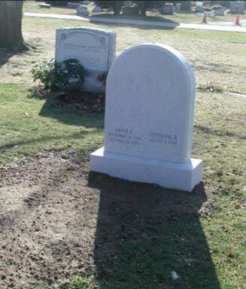
The Consequence of Adam’s Sin
Through one man sin entered the world, and death through sin, and thus death spread to all men, because all sinned
Romans 5:12

Slide 17

The Source of Sin
Each one is tempted when he is drawn away by his own desires and enticed.
Then, when desire has conceived, it gives birth to sin; and sin, when it is full-grown, brings forth death.
James 1:14-15

Slide 18
The Two-fold Problem
As a consequence of Adam’s sin:
We are mortal (subject to death)
We have a nature that is inherently prone to temptation and sin.

Slide 19
Our Problem
‘What then? Are we better than they? Not at all. For we have previously charged both Jews and Greeks that they are all under sin.
As it is written: “There is none righteous, no, not one”’
Romans 3:9-10
‘for all have sinned and fall short of the glory of God’
Romans 3:23

Slide 20
Our Problem
‘What then? Are we better than they? Not at all. For we have previously charged both Jews and Greeks that they are all under sin.
As it is written: “There is none righteous, no, not one”’
Romans 3:9-10
‘for all have sinned and fall short of the glory of God’
Romans 3:23

Slide 21
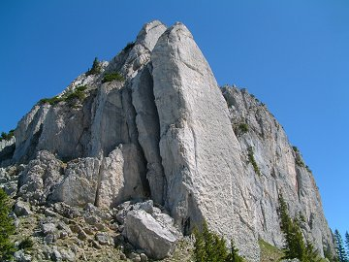
God is Unchanging
There is no other God besides Me, A Just God and a Saviour; There is none besides Me.
Isaiah 45:21
...that He might be Just and the Justifier of the one who has faith in Jesus.
Romans 3:26

Slide 22
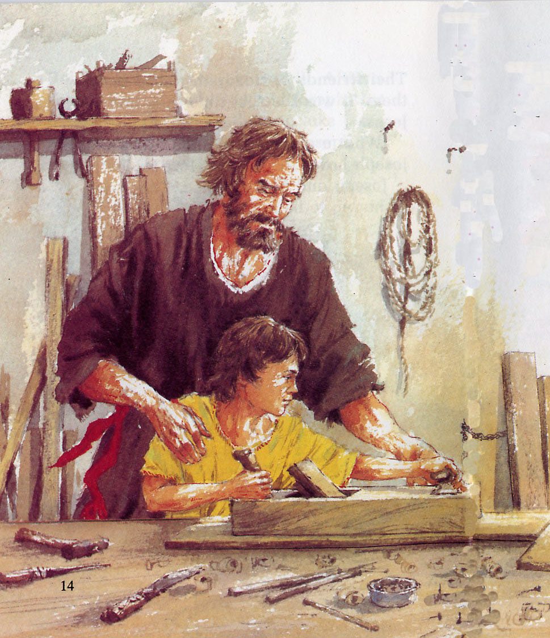
God’s Solution
For what the law could not do in that it was weak through the flesh, God did by sending His own Son in the likeness of sinful flesh, on account of sin: He condemned sin in the flesh
Romans 8:3

Slide 23
Jesus shared our nature
Inasmuch then as the children have partaken of flesh and blood, He himself likewise shared in the same, that through death He might destroy him who had the power of death, that is, the devil
Hebrews 2:14

Slide 24
Jesus shared our nature
Inasmuch then as the children have partaken of flesh and blood, He himself likewise shared in the same, that through death He might destroy him who had the power of death, that is, the devil
Hebrews 2:14

Slide 25
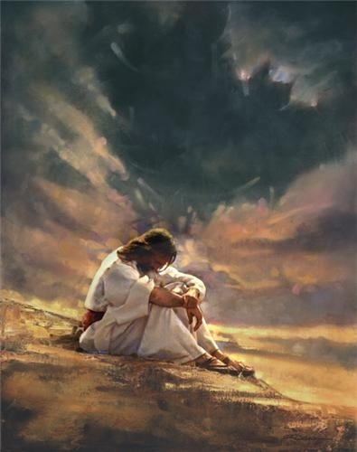
Tempted but Sinless
For we do not have a High Priest who cannot sympathize with our weaknesses, but was in all points tempted as we are, yet without sin.
Hebrews 4:15

Slide 26
Why Jesus had to Die
Romans 8:3
The source / generator of sin is the ‘flesh’ - i.e. Human Nature
Jesus shared that same physical nature (Heb 2:14)
Hebrews 4:15
Jesus was tempted - just like we are
BUT he never once sinned
Sin was condemned ‘in the flesh’

Slide 27
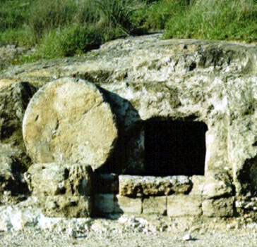
God’s Righteousness
Jesus of Nazareth ….whom God raised up, having loosed the pains of death, because it was not possible that He should be held by it.
Acts 2:24

Slide 28
God’s Righteousness
Christ, having been raised from the dead, dies no more. Death no longer has dominion over Him.
For the death that He died, He died to sin once for all
Romans 6:9-10

Slide 29
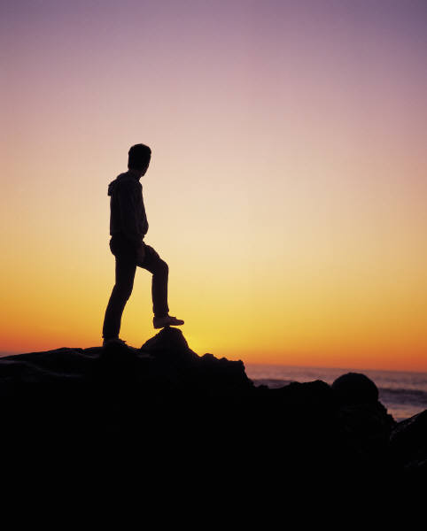
Becoming The ‘Last Adam’
And so it is written, “The first man Adam became a living being.” The last Adam became a life-giving spirit...
… The first man was of the earth, made of dust; the second Man is the Lord from heaven. As was the man of dust, so also are those who are made of dust; and as is the heavenly Man, so also are those who are heavenly. 1 Corinthians 15: 45, 47-48
For since by man came death, by Man also came the resurrection of the dead. For as in Adam all die, even so in Christ all shall be made alive.
1 Corinthians 15: 21-22

Slide 30
Becoming The ‘Last Adam’
Therefore, just as through one man sin entered the world, and death through sin, and thus death spread to all men, because all sinned……Therefore, as through one man’s offense judgment came to all men, resulting in condemnation, even so through one Man’s righteous act the free gift came to all men, resulting in justification of life. For as by one man’s disobedience many were made sinners, so also by one Man’s obedience many will be made righteous.
Rom 5: 12, 18-19

Slide 31
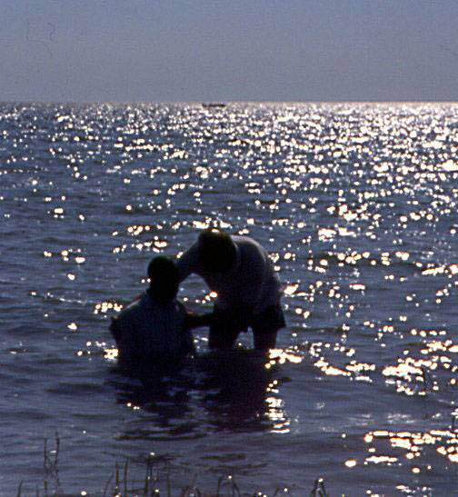
Crucified with Christ
Do you not know that all of us who have been baptized into Christ Jesus were baptized into his death?
We were buried therefore with him by baptism into death, in order that, just as Christ was raised from the dead by the glory of the Father, we too might walk in newness of life.
Romans 6:3-4

Slide 32
Baptized into Christ
For you are all sons of God through faith in Christ Jesus. For as many of you as were baptized into Christ have put on Christ…. And if you are Christ’s, then you are Abraham’s seed, and heirs according to the promise.
But when the fullness of the time had come, God sent forth His Son, born of a woman, born under the law, to redeem those who were under the law, that we might receive the adoption as sons….. Therefore you are no longer a slave but a son, and if a son, then an heir of God through Christ.
Gal 3: 26-27,29, 4: 4-5,7 .

Slide 33
Thanks be to God, who gives us the victory through our Lord Jesus Christ.
1 Cor. 15:57

Slide 34
Summary
As a consequence of Adam’s sin the whole human race is locked into a cycle of sin and death.
Though Jesus shared human nature, he never sinned.
By willingly going to the cross, Jesus acknowledged that God was just (right) to condemn Man to death.
The justice of God was also declared in the subsequent resurrection of His sinless Son.
God is prepared to forgive and save those who believe in Christ, commit their lives to him through baptism, and sincerely try to follow his example.

Slide 35
How to Be a Follower of Jesus

Slide 36
In a nutshell:
“Then he said to them all, ‘If anyone desires to come after me, let him deny himself, and take up his cross daily, and follow me.’”
Luke 9:23

Slide 37
Belief
“But without faith it is impossible to please him, for he who comes to God must believe that he is, and that he is a rewarder of those who diligently seek him.”
Hebrews 11:6

Slide 38
Belief, repentance
“Repent therefore and be converted, that your sins may be blotted out, so that times of refreshing may come from the presence of the Lord.”
Acts 3:19

Slide 39
Belief, repentance, baptism
Romans 6

Slide 40
Belief, repentance, baptism, the new life
“That you put off, concerning your former conduct, the old man which grows corrupt according to the deceitful lusts, and be renewed in the spirit of your mind, and that you put on the new man which was created according to God, in true righteousness and holiness.”
Ephesians 4:22-24

Slide 41
The Power of God’s word
The Bible:
Is the ‘incorruptible seed’ by which we are ‘born again’
1 Peter 1:23
‘Effectively works in you who believe’
1 Thessalonians 2:13
Is able to make us ‘wise for salvation through faith which is in Jesus Christ’
2 Timothy 3:15-17

Slide 42
God’s commandments
“‘You shall love the Lord your God with all your heart, with all your soul, and with all your mind.’ This is the first and great commandment. And the second is like it: ‘You shall love your neighbour as yourself.’ On these two commandments hang all the Law and the Prophets.”
Matthew 22:37-40

Slide 43
What would Jesus do?
Would Jesus be in this place?
Would Jesus be reading this?
Would Jesus watch this?
How would Jesus treat this person?
Would Jesus say this?

Slide 44
True peace of mind
“Therefore, having been justified by faith, we have peace with God through our Lord Jesus Christ…

Slide 45
True peace of mind
“Therefore, having been justified by faith, we have peace with God through our Lord Jesus Christ, through whom we have access by faith into this grace in which we stand, and rejoice in hope of the glory of God.”
Romans 5:1-2

Slide 46
The Bible in a Nutshell
Summary of the Day

Slide 47
Summary of Day
We have presented to you today the Gospel taught by Jesus Christ and the Apostles.
We have seen that it is amazingly relevant to:
  The needs of the world
  Our personal needs.

Slide 48
Summary of Day
Why we should trust the Bible
  Jesus trusted the O.T. & used it in preaching the gospel
  Evidence why WE should trust the Bible
  Kingdom of God Explained
  Teaching of Jesus & the apostles
  The Promises made by God
  Jesus – the promised Messiah
  Restoration of the Kingdom of Israel
  Future Kingdom on Earth

Slide 49
Summary of Day
A New World needs New People
  What is wrong with us?
  Why Jesus was crucified
  What it takes to be a follower of Jesus

Slide 50
Summary of Day
No other religion or way of life can address our needs and give us real hope and confidence for the future:
    Only the Bible explains our real needs
    Christianity is the only religion with a Saviour, the Lord Jesus, who has personally conquered sin and death
God has a plan for a New World
– and you can be part of it!

Slide 51
The Bible in a Nutshell
The End

